Slide 1

VISVODAYA ENGINEERING COLLEGE, KAVALI DEPARTMENT OF CSE PRESENTED BY V.LAKSHMI LIKHITHA(194N1A0535) A.JAYASRI(194N1A0514) B.VENNELA SREEJA(194N1A0516) CH.MAHENDRA(194N1A0540)

Slide 2
NETWORK INTRUSION DETECTION USING SUPERVISED MACHINE LEARNING TECHNIQUE WITH FEATURE SELECTION

Slide 3
Outline
Abstract
Existing system
Proposed system
Advantages
System architecture
Software requirements
Modules
Uml diagrams
Conclusion
Literature survey
Questions

Slide 4
Abstract
A novel supervised machine learning system is developed to classify network traffic whether it is malicious or benign. To find the best model considering detection success rate, combination of supervised learning algorithm and feature selection method have been used. Through this study, it is found that Artificial Neural Network (ANN) based machine learning with wrapper feature selection outperform support vector machine (SVM) technique while classifying network traffic. To evaluate the performance, NSL-KDD dataset is used to classify network traffic using SVM and ANN supervised machine learning techniques. Comparative study shows that the proposed model is efficient than other existing models with respect to intrusion detection success rate.

Slide 5
Existing System
Studying the field of intrusion detection first started in 1980 and the first such model was published in 1987 [7].
For the last few decades, though huge commercial investments and substantial research were done, intrusion detection technology is still immature and hence not effective [7].
While network IDS that works based on signature have seen commercial success and widespread adoption by the technology based organization throughout the globe, anomaly based network IDS have not gained success in the same scale.
Due to that reason in the field of IDS, currently anomaly based detection is a major focus area of research and development [8]. And before going to any wide scale deployment of anomaly based intrusion detection system, key issues remain to be solved [8].
But the literature today is limited when it comes to compare on how intrusion detection performs when using supervised machine learning techniques [9]

Slide 6
Proposed System
In this paper author is evaluating performance of two supervised machine learning algorithms such as SVM (Support Vector Machine) and ANN (Artificial Neural Networks).
Machine learning algorithms will be used to detect whether request data contains normal or attack (anomaly) signatures.
Now-a-days all services are available on internet and malicious users can attack client or server machines through this internet and to avoid such attack request IDS (Network Intrusion Detection System) will be used, IDS will monitor request data and then check if its contains normal or attack signatures, if contains attack signatures then request will be dropped.
IDS will be trained with all possible attacks signatures with machine learning algorithms and then generate train model, whenever new request signatures arrived then this model applied on new request to determine whether it contains normal or attack signatures.

Slide 7
IDS will be trained with all possible attacks signatures with machine learning algorithms and then generate train model, whenever new request signatures arrived then this model applied on new request to determine whether it contains normal or attack signatures.
In this paper we are evaluating performance of two machine learning algorithms such as SVM and ANN and through experiment we conclude that ANN outperform existing SVM in terms of accuracy.

Slide 8
HARDWARE REQUIREMENTS
Hardware Requirements
This is an project so hardware plays an important role. Selection of hardware also plays an important role in existence and performance of any software. The size and capacity are main requirements.
Operating system : windows, linux
Processor : minimum intel i3
Ram : minimum 4 GB
Hard disk : minimum 500GB

Slide 9
SOFTWARE REQUIREMENTS
Software Requirements
The software requirements specification is produced at the end of the analysis task. Software requirement is a difficult task, For developing the Application
Python ideal 3.7 version (or)
Anaconda 3.7 ( or)
Jupiter (or)
Google colab

Slide 10
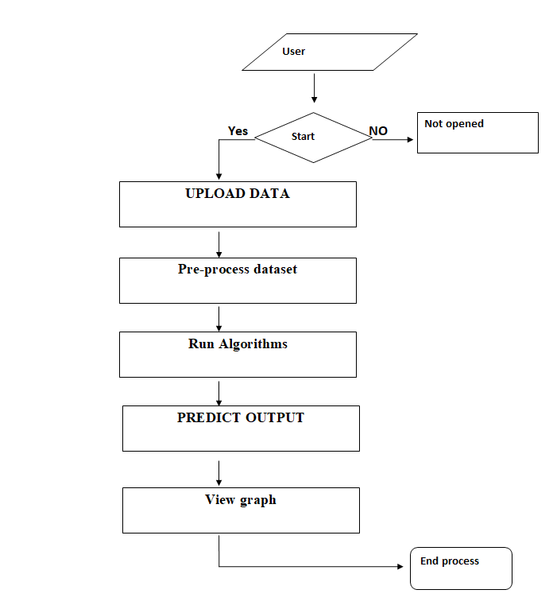
ARCHITECTURE

Slide 11
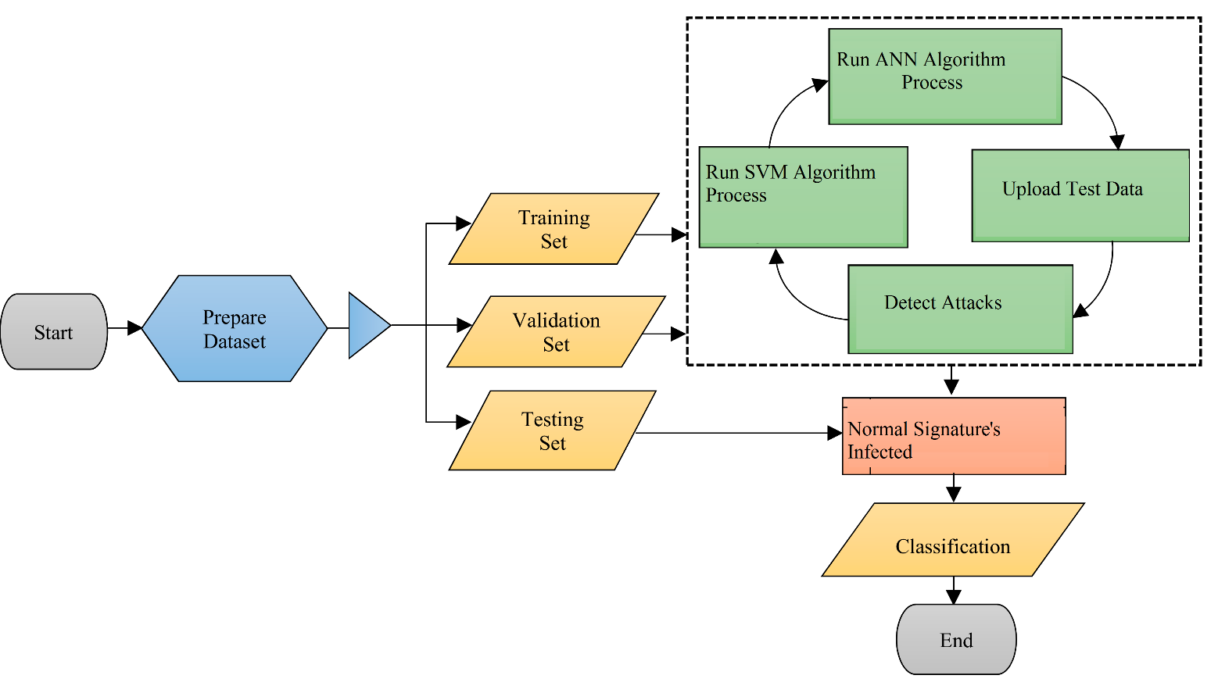
State Chart Diagram

Slide 12
Advantages
Better prediction
Better accuracy
Build trust
Access control
Application security

Slide 13
Literature survey
[1] H. Song, M. J. Lynch, and J. K. Cochran, “A macro-social exploratory analysis of the rate of interstate cyber-victimization,” American Journal of Criminal Justice, vol. 41, no. 3, pp. 583–601, 2016.
[2] P. Alaei and F. Noorbehbahani, “Incremental anomaly-based intrusion detection system using limited labeled data,” in Web Research (ICWR), 2017 3th International Conference on, 2017, pp. 178–184.
[3] M. Saber, S. Chadli, M. Emharraf, and I. El Farissi, “Modeling and implementation approach to evaluate the intrusion detection system,” in International Conference on Networked Systems, 2015, pp. 513–517.
[4] M. Tavallaee, N. Stakhanova, and A. A. Ghorbani, “Toward credible evaluation of anomaly-based intrusion-detection methods,” IEEE Transactions on Systems, Man, and Cybernetics, Part C (Applications and Reviews), vol. 40, no. 5, pp. 516–524, 2010.
[5] A. S. Ashoor and S. Gore, “Importance of intrusion detection system (IDS),” International Journal of Scientific and Engineering Research, vol. 2, no. 1, pp. 1–4, 2011.

Slide 14
ANY QUERIES?

Slide 15
THANK YOU

